Slide 1

Barclays Hack-o-Hire
Prototype Submission Phase

Slide 2
TEAM NAME and MEMBER DETAILS
Team ID - T304
Member 1 - Ninad Gawali
Member 2 - Ishaan Chepurwar
Member 3 - Orison Bachute
Member 4 - Purvi Solanki
Member 5 - Sahishnu G
THEME:
TermSheet Validation using AI

Slide 3

PROBLEM STATEMENT
Financial institutions process numerous term sheets daily, but manual reviews cause delays, errors, and compliance risks. The problems faced by these Institutions include
High Volume of Term Sheets - 500,000+ term sheets monthly delay settlements and risk million-dollar daily losses.
High Rate of Human Errors – 10–15% of manual reviews contain errors, causing 50–60% of trade discrepancies.
Compliance and Regulatory Risks – 40% of fines come from validation mistakes, totaling $10B+ in 2022.
Inefficient Resource Utilization –Legal teams spend 40% of their time on manual reviews, costing $250–$500 per review.
No Secure Audit Trail or Version Tracking – 60% of term sheets go through multiple revisions, leading to 20% of disputes.
Inability to Identify Risky Clauses Automatically – 30–40% contain high-risk clauses, leading to $2.5B in losses every year.
Poor Workflow Management –50% of delays come from inefficient routing, misrouting causes 40% of review delays.

Slide 4

OUR PROPOSED SOLUTION
We’re making Term Sheet processing faster, smarter, and hassle-free with AI.
Instead of slow, error-prone manual reviews, AI will catch mistakes and flag risky clauses instantly.
A secure, organized system will keep track of every version, so nothing gets lost or outdated.
Teams can collaborate in real time, avoiding endless email back-and-forth.
Smart automation ensures documents reach the right person, directs issues to relevant teams (finance, legal, etc.), and alerts the middle office.
Plus, easy-to-read dashboards will provide key insights, and Google Calendar integration will help prioritize urgent deals.
Everything seamlessly fits into existing systems, saving time, reducing risks, and cutting costs.

Slide 5
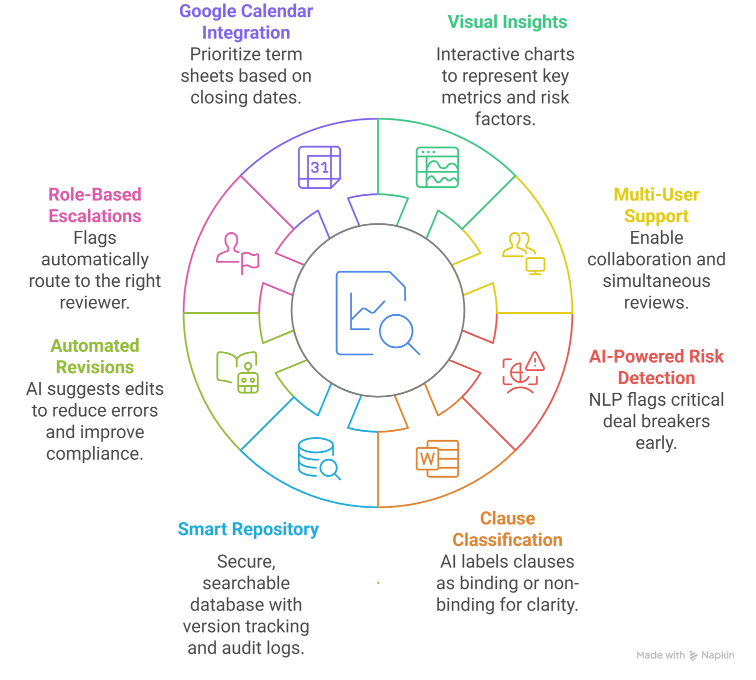
INNOVATION

Slide 6
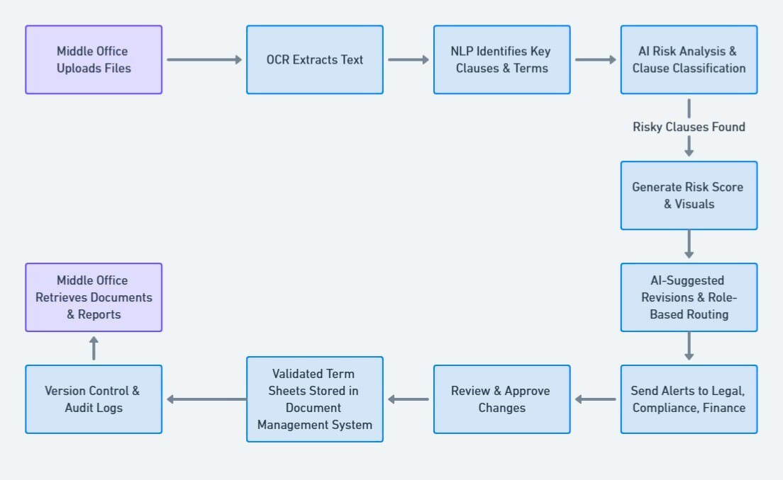
USE CASE DIAGRAM / USER FLOW

Slide 7
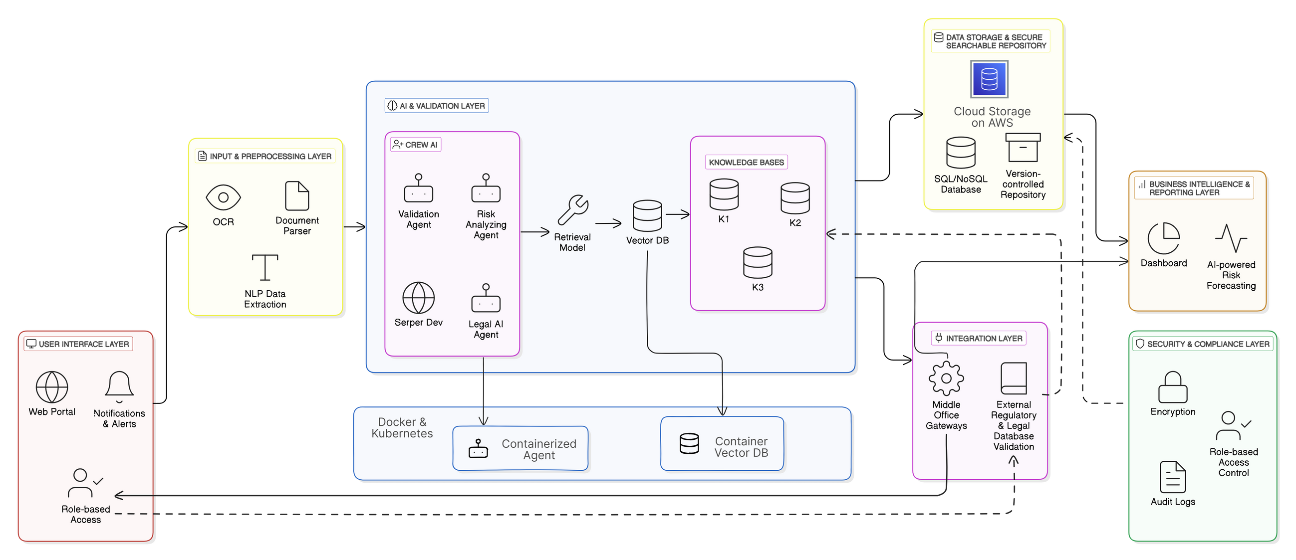
SYSTEM ARCHITECTURE

Slide 8
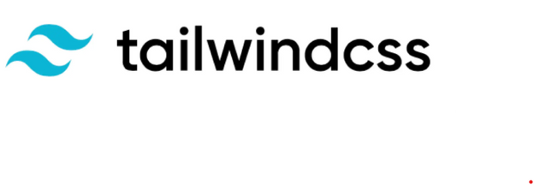

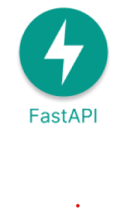




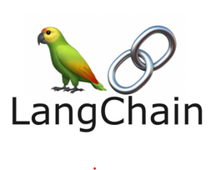


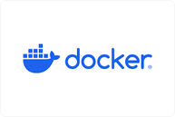




TECH STACK
Frontend & UI
Backend frameworks
AI/ML & LLMs
Database
Cloud services and DevOps

Slide 9
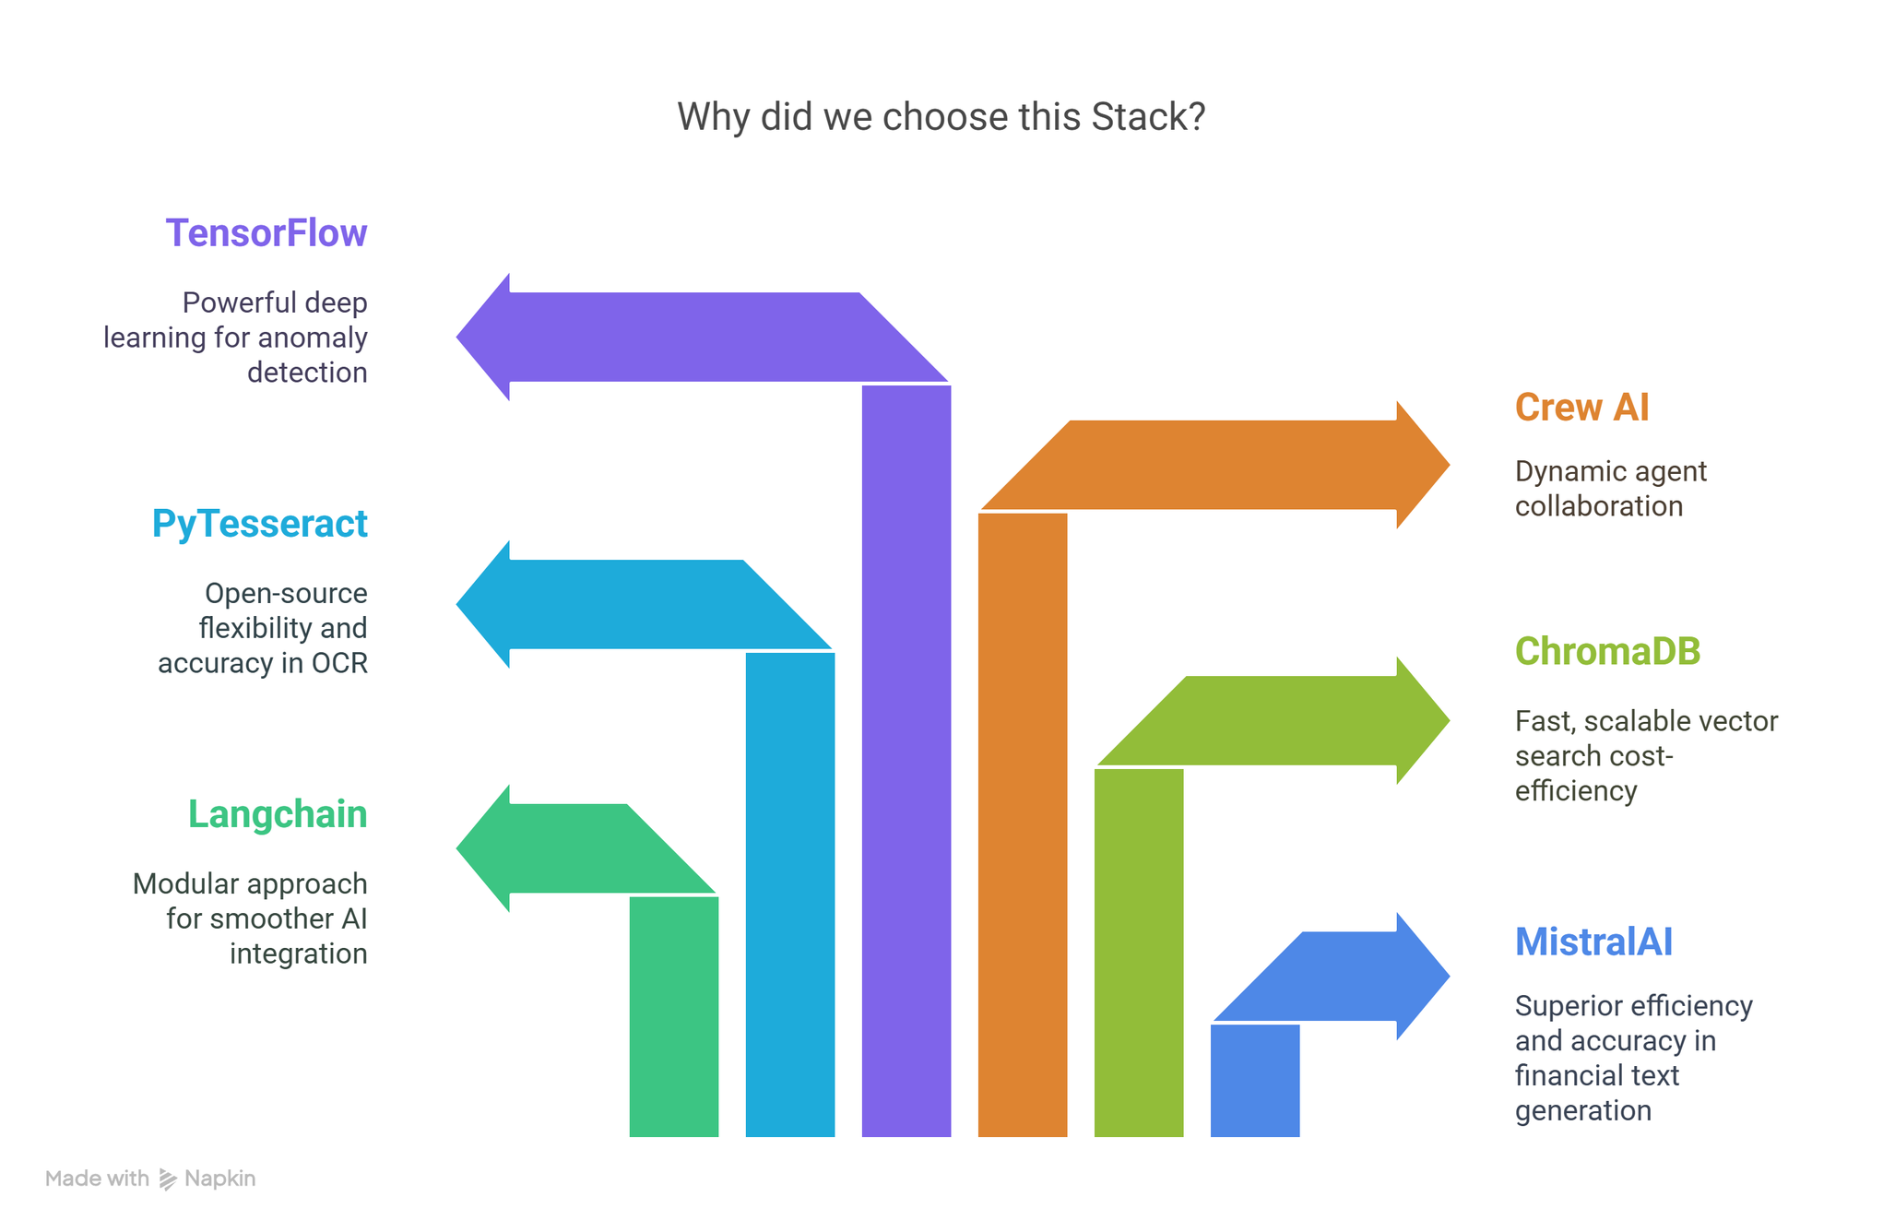
Gen-AI & ML STACK

Slide 10


BUSINESS IMPACT
1)Increased Efficiency & Productivity
AI automates term sheet validation, reducing manual efforts by up to 80%.
Cuts validation time from hours to minutes per document.
2)Improved Accuracy & Risk Reduction
AI detects missing clauses, conflicting terms, and risky language that humans may
overlook.
Ensures compliance with financial regulations such as SEC, Basel III, and MiFID.
3)Cost Savings & Return on Investment
Reduces manual labor costs by automating document validation.
Reduces compliance costs by preventing regulatory fines and legal issues.
4)Competitive Advantage & Business Insights
Accelerates trade approvals and financial transactions.
Provides real-time insights for risk assessment and decision-making.

Slide 11

COMPETITORS VS OUR SOLUTION
Feature | Our Solution | Luminance | Ironclad
Visual Insights | Interactive charts for key metrics & risks | ❌ | ❌
Multi-User Support | Real-time collaboration | ❌ | Yes
AI Risk Detection | NLP flags critical deal breakers | AI-driven compliance | Clause flagging
Clause Classification | AI labels binding/non-binding clauses | ❌ | ❌
Smart Repository | Secure, searchable, version-tracked storage | Granular insights | Centralized contracts
Automated Revisions | AI-suggested edits & compliance improvements | AI redlining | AI redlining
Role-Based Escalations | Auto-routes flags to relevant reviewers | ❌ | Custom workflows
Google Calendar Sync | Prioritizes based on closing dates | ❌ | ❌
Middle-Office Integration | Connects with financial systems | Microsoft & Salesforce | Workflow integrations

Slide 12
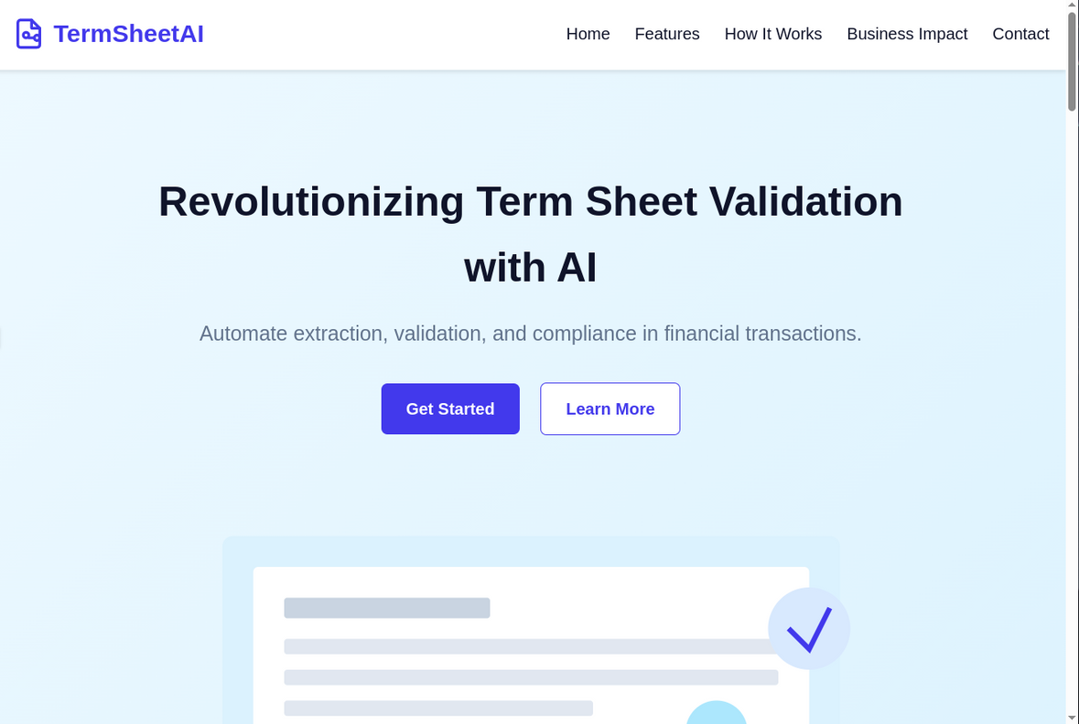
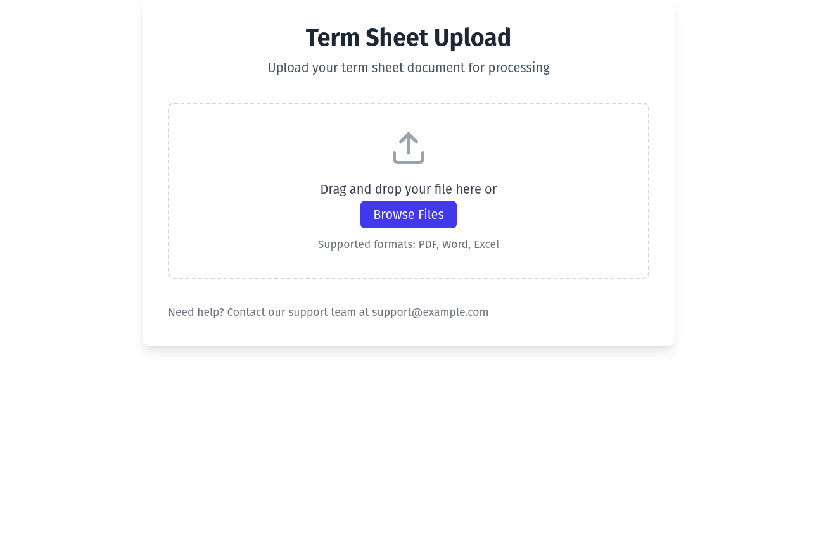
PROTOTYPE (Website Screenshots)

Slide 13
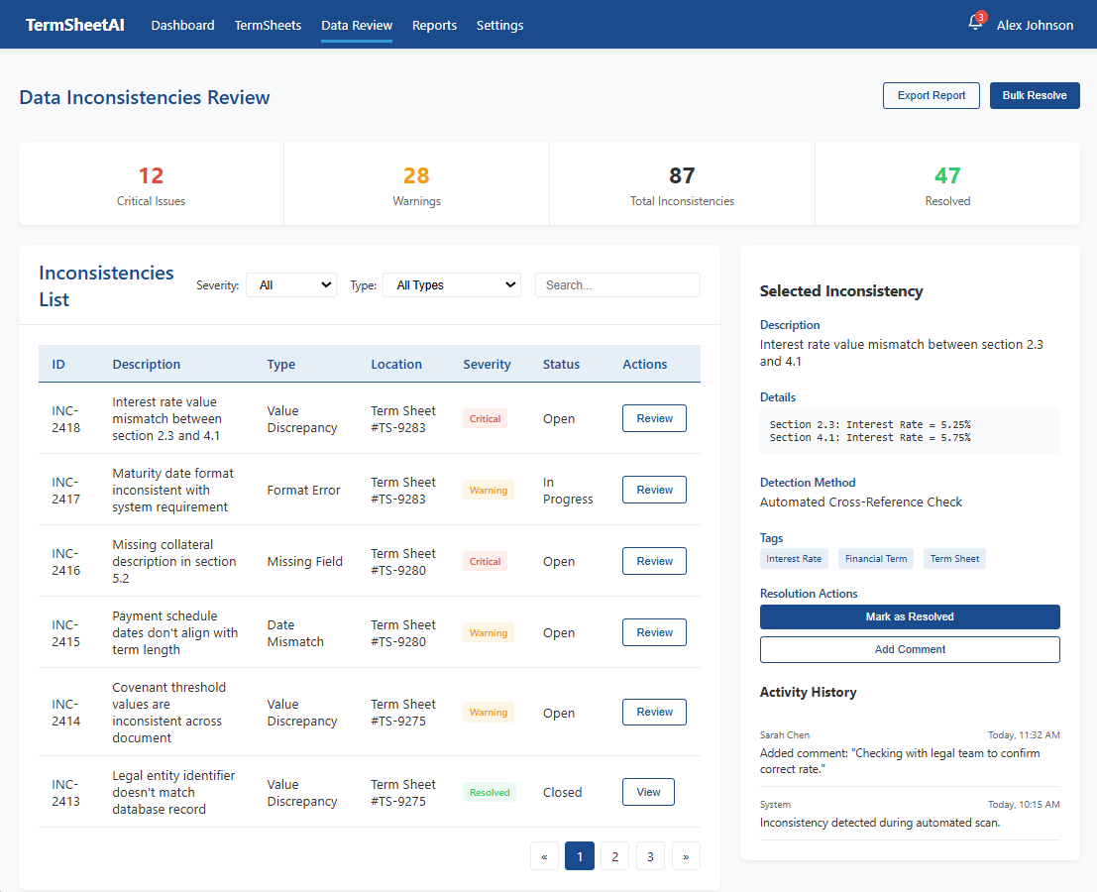
PROTOTYPE (Website Screenshots)

Slide 14
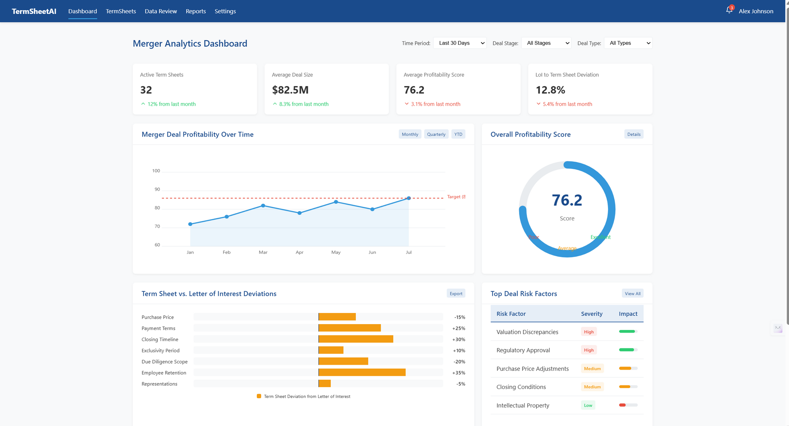
PROTOTYPE (Website Screenshots)

Slide 15
THANK YOU
Team Name - BrainStormers
Click Here for References

